Slide 1
Discrete Maths Project
ELLIPTIC CURVE CRYPTOGRAPHY

Slide 2
What is Cryptography and its use !
Cryptography is an information security method which is used for protecting enterprise information and communication from cyber threats.
It uses Mathematical concepts and algorithms to transform information in ways that are hard to decrypt.
In our daily life, the use of cryptography is everywhere. We use it to securely send passwords to the servers of different websites. Passwords can be stored securely using cryptography. For example, bank servers and email clients use cryptography to save passwords. Cryptography is also used to secure all transmitted information.

Slide 3
History Of Cryptography
Cryptography was used for the first time by Spartans to send messages during war using device called Scytale.
Julius Caesar invented a substitution cypher, in which all the characters of sentence being shifted by 3 places to create encrypted message.
There are different types of cryptosystems used for different purposes. For example,
RSA Cryptosystem is used for data encryption and other digital transactions over the internet
ECC (Elliptic Curve Cryptosystem), which is used to prove ownership of cryptocurrency. It is also used to provide signatures in Apple's iMessage service.

Slide 4
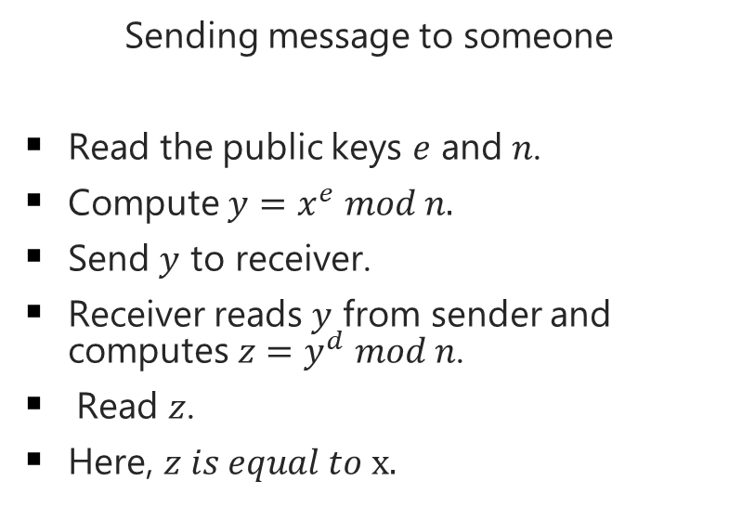
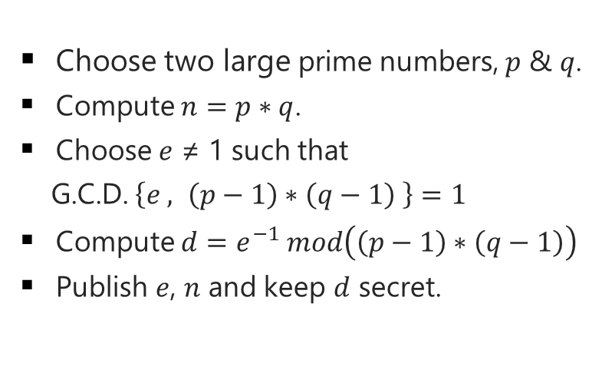
RSA Cryptosystem
Algorithm :
Sending message to someone
Read the public keys $e$ and $n$.
Compute $y=x^{e} mod n.$
Send $y$ to receiver.
Receiver reads $y$ from sender and computes $z=y^{d} mod n$.
Read $z$.
Here, $z is equal to x.$
Choose two large prime numbers, $p$ & $q$.
Compute $n=p∗q$.
Choose $e$ ≠ 1 such that
G.C.D. $\left\{e , \left(p−1\right)∗\left(q−1\right) \right\}=1$
Compute $d=e^{−1} mod\left(\left(p−1\right)∗\left(q−1\right)\right)$
Publish $e$, $n$ and keep $d$ secret.

Slide 5



























$$RSA Example$$
$Suppose Alice wants to send a message ′HI′ to Bob$
$Public Keys$
$n=91$
$e=5$
$$Alice$$
$$Bob$$
$Private Keys$
$Encryption of ′H′$ (ASCII Value = 72)
$p=13$
$q=7$
$y≡{72}^{5} mod 91$
$d≡5^{−1} mod 72$
$y=11 (Publishing)$
$d=29$
$Decryption of ′H′$
$y=11$
$z{≡11}^{29} mod 91$
$Encryption of ′I′$ (ASCII Value = 73)
z $=72$
$y≡{73}^{5} mod 91$
$Decryption of ′I′$
$y=47 (Publishing)$
$y=47$
$z{≡47}^{29} mod 91$
z $=73$

Slide 6
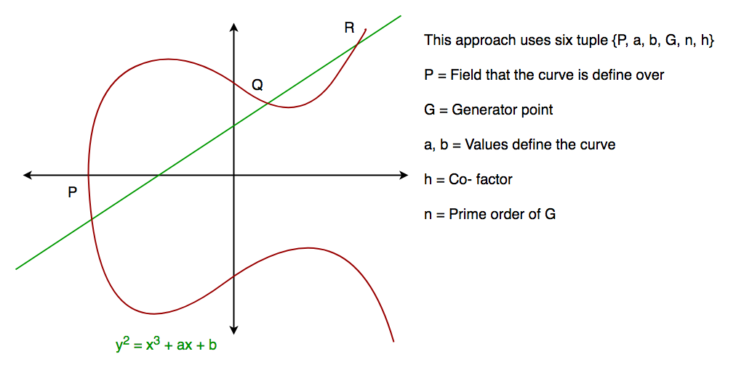
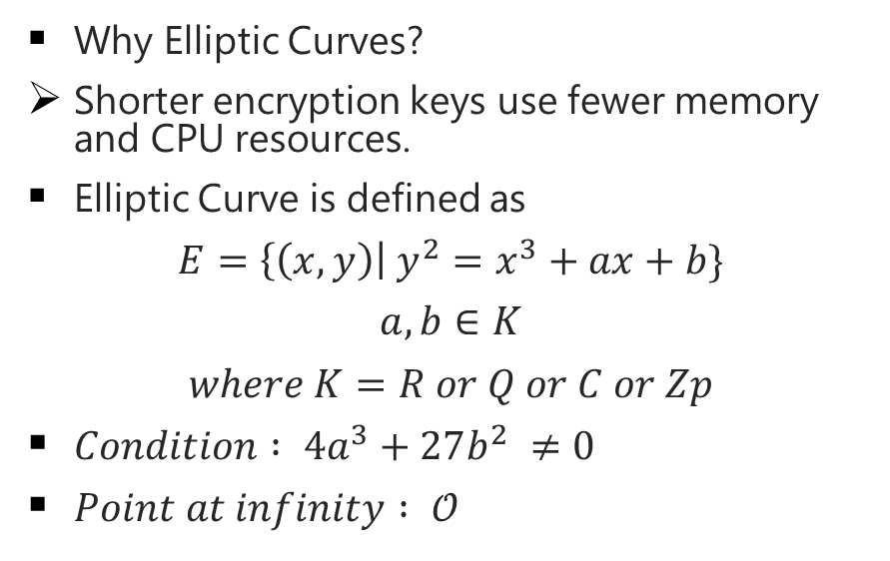
Introduction To Elliptic Curve
Why Elliptic Curves?
Shorter encryption keys use fewer memory and CPU resources.
Elliptic Curve is defined as
$$E=\left\{\left(x,y\right)\right| y^{2}=x^{3}+ax+b\}$$
$$a,b∈K$$
$$where K=R or Q or C or Zp$$
$Condition : 4a^{3}+27b^{2} ≠0$
$Point at infinity : 𝒪$

Slide 7
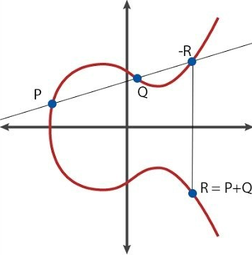
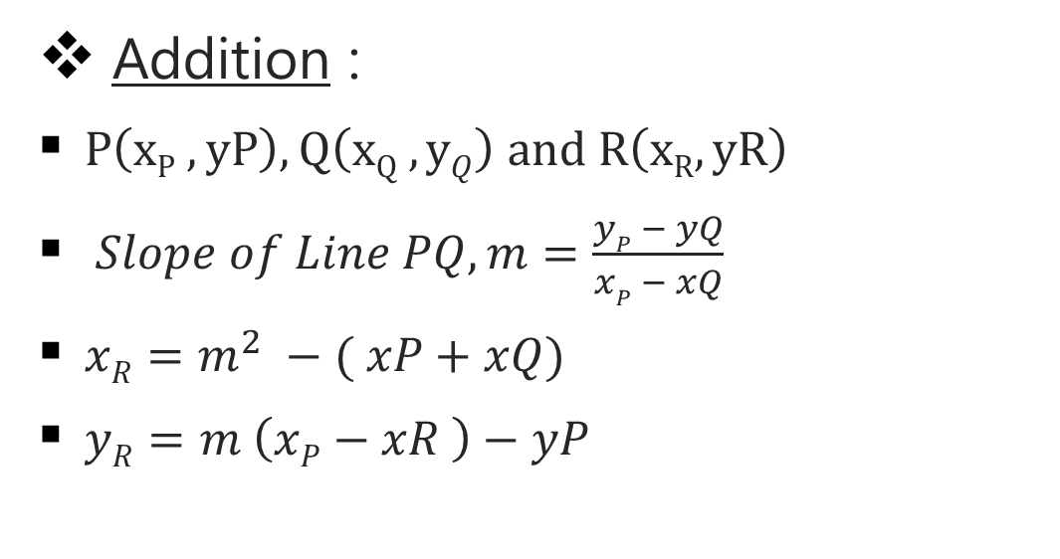
Group Operations
Addition :
$P\left(xP , yP\right), Q\left(xQ , yQ\right) and R\left(xR,yR\right)$
$Slope of Line PQ, m=\frac{yP − yQ}{xP − xQ}$
$xR=m^{2} −( xP+xQ)$
$yR=m \left(xP−xR \right)−yP$

Slide 8
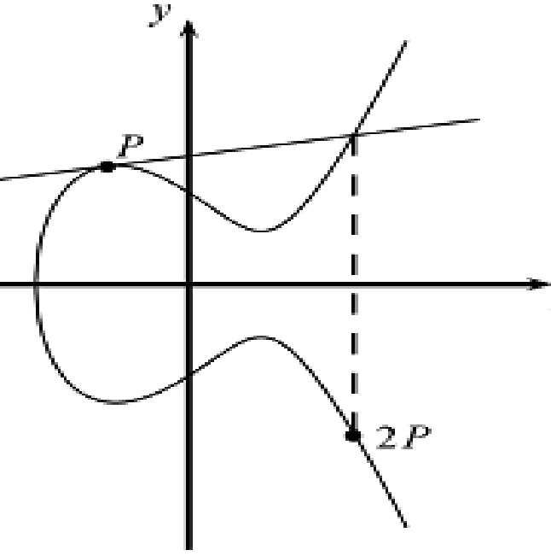
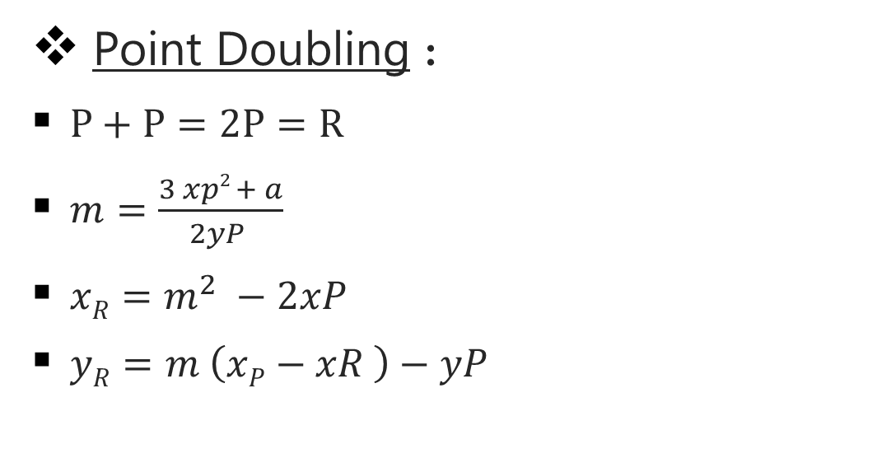
Group Operations
Point Doubling :
$P+P=2P=R$
$m=\frac{3 xp2 + a}{2yP }$
$xR=m^{2} −2xP$
$yR=m \left(xP−xR \right)−yP$

Slide 9
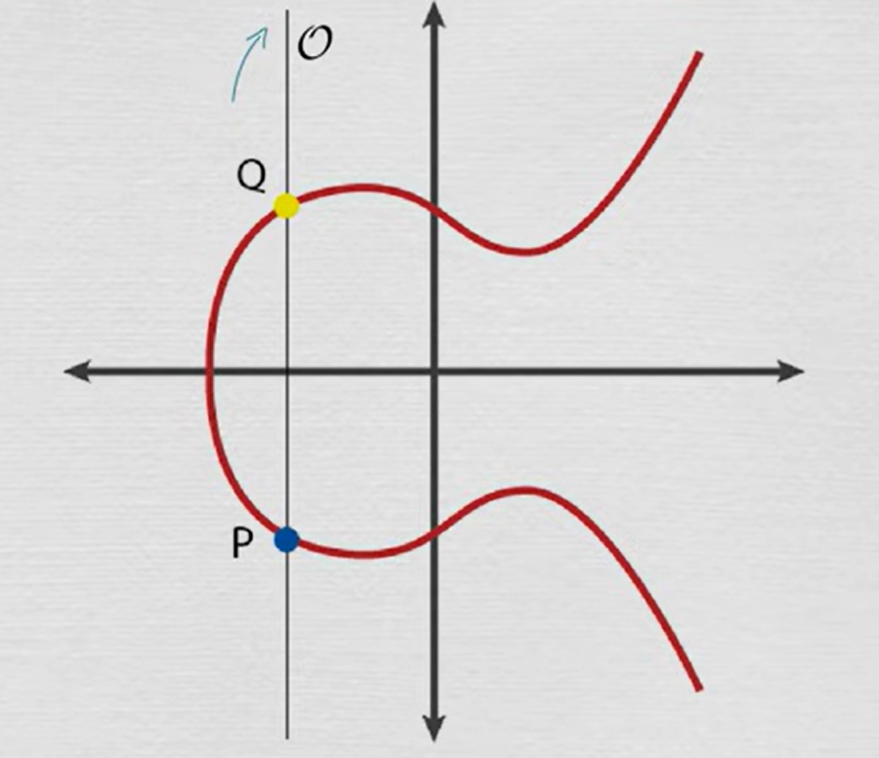
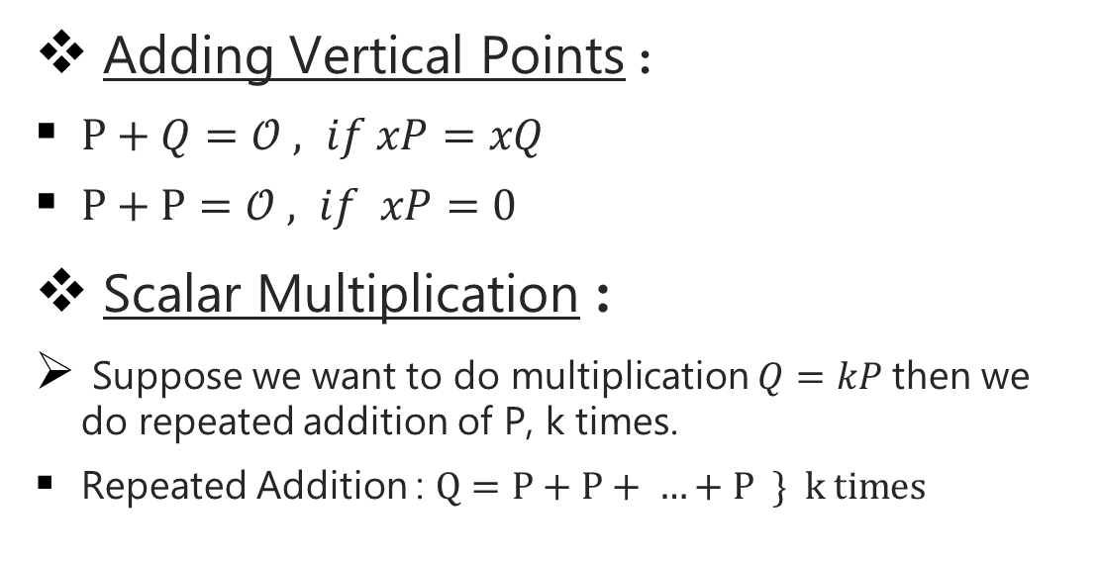
Group Operations
Adding Vertical Points :
$P+Q=𝒪 , if xP=xQ$
$P+P=𝒪 , if xP=0$
Scalar Multiplication :
Suppose we want to do multiplication $Q=kP$then we do repeated addition of P, k times.
Repeated Addition : $Q=P+P+ …+P \} k times$

Slide 10
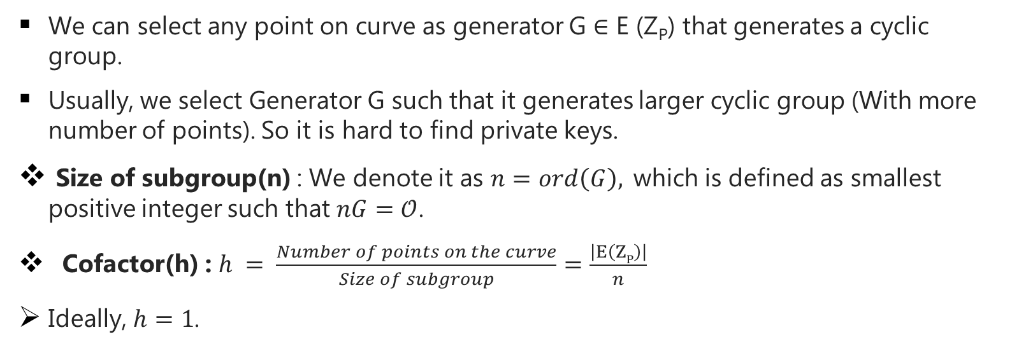
The Base Point (Generator) and Cofactor
We can select any point on curve as generator G $∈$ E (Z_{P}) that generates a cyclic group.
Usually, we select Generator G such that it generates larger cyclic group (With more number of points). So it is hard to find private keys.
Size of subgroup(n) : We denote it as $n=ord\left(G\right),$which is defined as smallest positive integer such that $nG=𝒪$.
Cofactor(h) : $h = \frac{Number of points on the curve}{Size of subgroup}=\frac{\left|E\left(ZP\right)\right|}{n}$
Ideally, $h=1$.

Slide 11
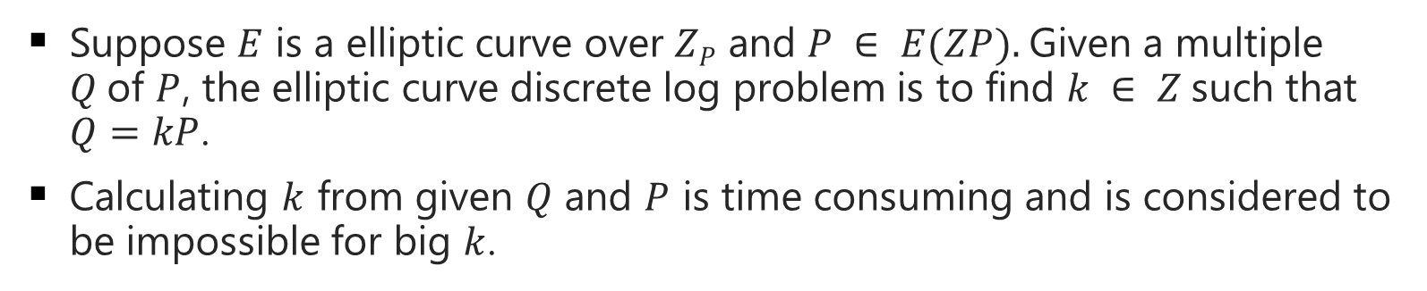
Elliptic Curve Discrete Logarithm Problem
Suppose $E$ is a elliptic curve over $ZP$ and $P ∈ E(ZP).$Given a multiple $Q$of $P$, the elliptic curve discrete log problem is to find $k ∈ Z$such that $Q=kP$.
Calculating $k$ from given $Q$ and $P$ is time consuming and is considered to be impossible for big $k$.

Slide 12
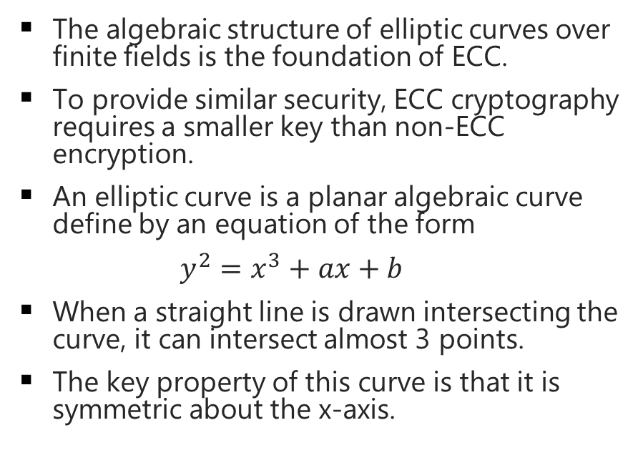
Elliptic Curve Cryptography (ECC)
The algebraic structure of elliptic curves over finite fields is the foundation of ECC.
To provide similar security, ECC cryptography requires a smaller key than non-ECC encryption.
An elliptic curve is a planar algebraic curve define by an equation of the form
$y^{2}=x^{3}+ax+b$
When a straight line is drawn intersecting the curve, it can intersect almost 3 points.
The key property of this curve is that it is symmetric about the x-axis.

Slide 13

















$$\text{Diffie} \text{Hellman} \text{Key}\text{−}\text{Exchange}$$
$Public Keys$
P $=10$
G $=1$8
$$Alice$$
$$Bob$$
$Private Key a =$ 4
$Private Key b=5$
$x≡G^{a} mod P$
$y≡G^{b} mod P$
$x≡{18}^{4} mod 10$
$y≡{18}^{5} mod 10$
$x=6$
$y=8$
$Computes ka≡y^{a} mod P$
$Computes kb≡x^{b} mod P$
$ka {≡8}^{4} mod \text{10}$
$kb≡6^{5} mod 10$
$ka=6$
$kb=6$
$After exchanging the keys , they both have the same secret key to encrypt$

Slide 14










$$\text{Elliptic} \text{Curve} \text{Diffie} \text{Hellman}$$
$Equation :y^{2}=x^{3}+ax+b$
$Public Keys :p, a, b, G, n, h$
$$Alice$$
$$Bob$$
$Private Key : α (1≤α≤n−1)$
$Private Key : β (1≤β≤n−1)$
$Computes A=αG and sends A to Bob$
$Computes B=βG and sends B to Alice$
$Recieves B=(xB ,yB) from Bob$
$Recieves A=(xA , yA) from Alice$
$Computes P=αB$
$Computes P=βA$
$Now, they both have the same key. So it can be used to verify each other and transfer data$.

Slide 15











$$\text{Elliptic} \text{Curve} \text{Diffie} \text{Hellman}$$
$Equation :y^{2}=x^{3}+x+2$
$Public Keys : p=17, a=1, b=2 , G =\left(4 , 6\right)$
$$Alice$$
$$Bob$$
$G=(4 , 6)$
$5G=(10 , 14)$
$2G=(1 , 2)$
$6G=(1 , 15)$
$3G=(10 , 3)$
$7G=(4 , 11)$
$4G=(16 , 0)$
$8G= 𝒪$
$Here 8G became point at infinity. So n=8.$
$h=\frac{17}{8}≈2$

Slide 16









$$\text{Elliptic} \text{Curve} \text{Diffie} \text{Hellman}$$
$Equation :y^{2}=x^{3}+x+2$
$Public Keys : p=17, a=1, b=2 , G =\left(4 , 6\right)$
$$Alice$$
$n=8 \& h=2$
$$Bob$$
$Private Key : α=6$
$Private Key : β=7$
$Computes A=6G=(1 , 15) and sends A to Bob$
$Computes B=7G=(4 , 11) and sends B to Alice$
$Recieves B=(4 , 11) from Bob$
$Recieves A=(1 , 15) from Alice$
$Computes P=αB=6B=(1 , 2)$
$Computes P=βA=7A=(1 , 2)$
$Now, they both have the same key (1 , 2). So it can be used to verify each other and transfer data$.

Slide 17
Thank You
By Shrut Kalathiya and Vandit Bhalani

